Slide 1
Do we Have the Tools we Need to Navigate
The New World of Data?
Dave Campbell
Technical Fellow
Microsoft

Slide 2

?
Notes:
Could you have imagined 2 years ago, that Microsoft would have been up here talking about Hadoop?

Slide 3

VALUE
INSIGHTS & ACTION
KNOWLEDGE
INFORMATION
DATA
SIGNAL
REFINE

Slide 4
VALUE
WORLD
DATA
COMMUNITY
DATA
ORGANIZATIONAL
DATA
MY
DATA
COMBINE

Slide 5
VALUE
Insights &
Actions
KNOWLEDGE
INFORMATION
Recommend
Share
DATA
WORLD DATA
Integrate
COMMUNITY DATA
Publish
Discover
SIGNAL
ORGANIZATIONAL DATA
MY DATA
REFINE
COMBINE

Slide 6
If it’s all about Insights:
More Data is better
What if Data Finds Data?

Slide 7

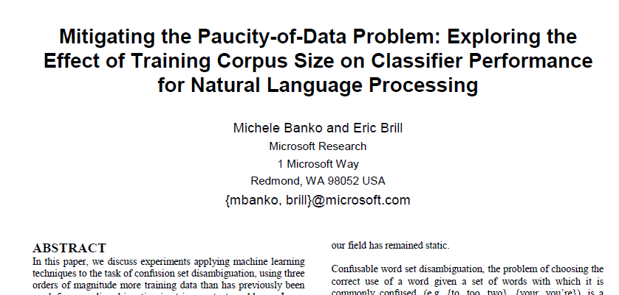
Notes:
Simple models and a lot of data trump more elaborate models based on less data.
Natural Language Processing is a great example where large amounts of imperfect data is more valuable than small amounts of perfect information.
The first lesson of Web-scale learning is to use available large-scale data rather than hoping for annotated data that isn’t available.

Slide 8

Notes:
Story about the Haitian Creole to English translation work that was done by the Translator team at MSR during the 2010 earthquake
Background:
- Approximately seven out of every eight people in Haiti speak the language.
- Since Haitian Creole is not widely spoken outside of Haiti, it became obvious that Machine Translation might be a useful tool for the relief effort.
- It could be applied to translate emergency relief documents, medical documents, SMS text messages, and even common phrases and expressions.
- Unfortunately, no readily available Machine Translation engine existed for Haitian Creole at the time.

Slide 9
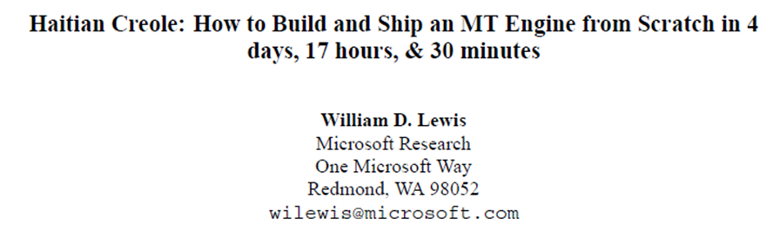
http://tinyurl.com/7k445pb
Notes:
MSR received an e-mail from colleagues on the ground in Haiti asking if we could develop a translation engine to aid in the relief effort.
And built a Statistical Machine Translation Engine from Scratch in 4 days, 17 hours, & 30 minutes

Slide 10
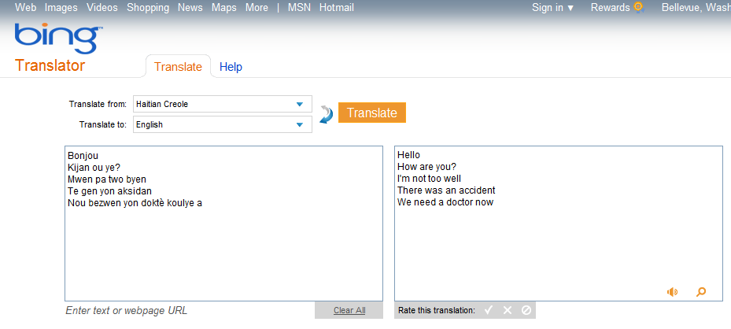
Notes:
Those efforts have now been transferred into the Bing Translator service and is readily available for anyone to use.
Had the ‘corpus’ of data been readily available for the team to use from the beginning, building the translator could have been reduced from days to hours.

Slide 11
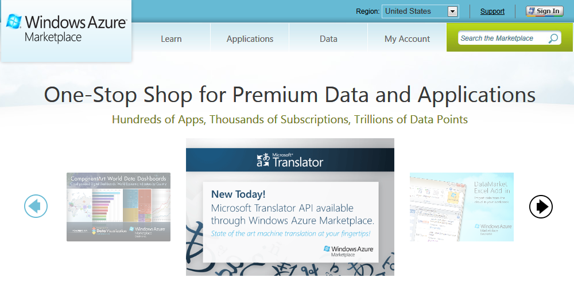
Marketplace
datamarket.azure.com

Slide 12
More Data is better
Any Data | Any Size | Anywhere

Slide 13
Data Finds Data

Slide 14
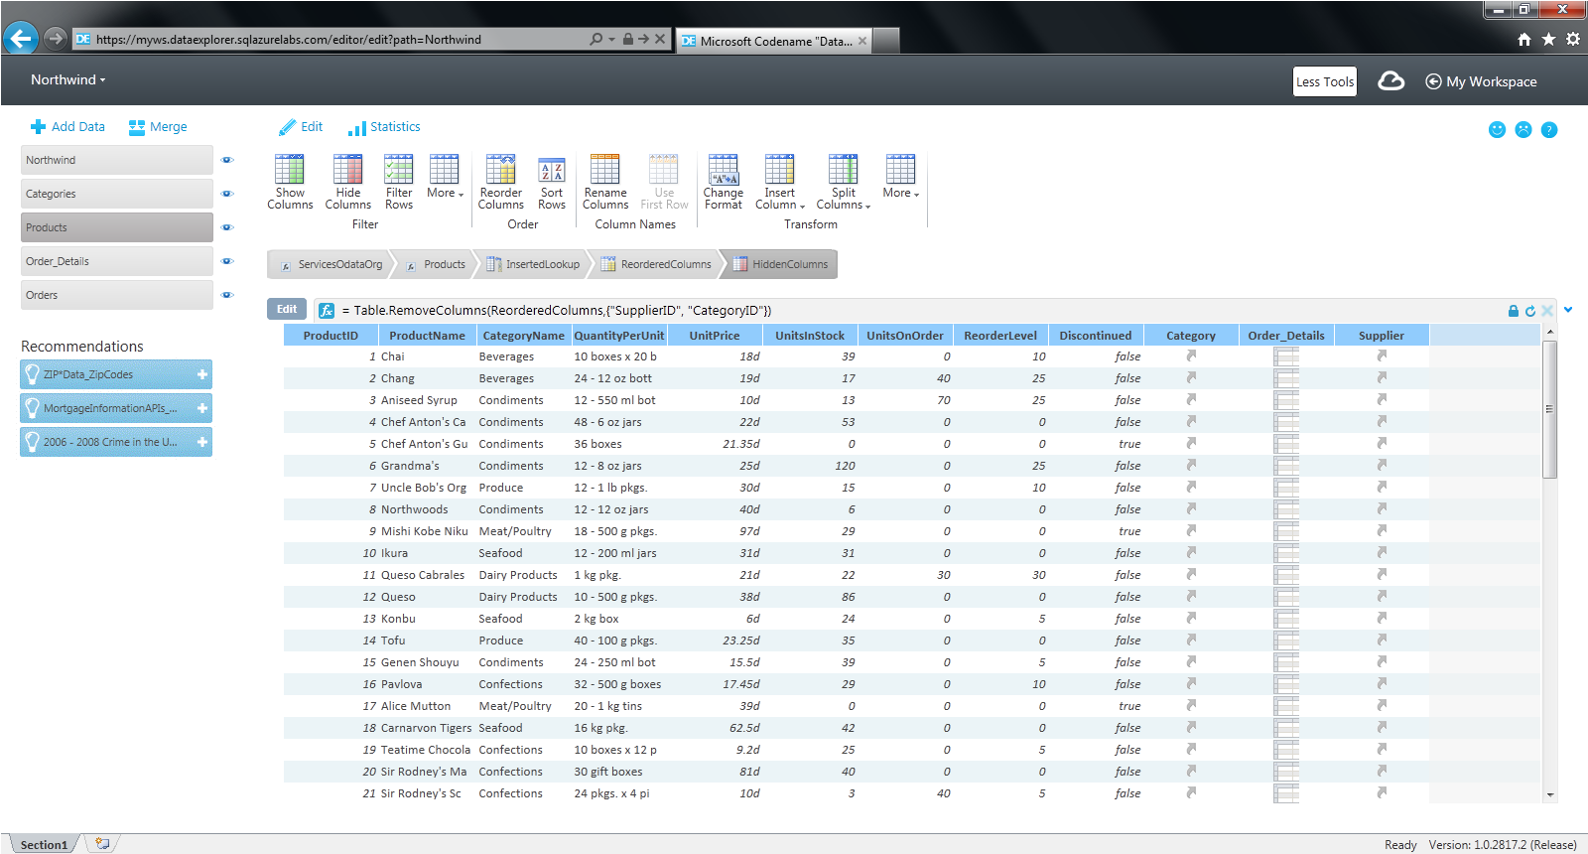
Azure Labs: Data Explorer
Notes:
The three recommendations are being offered because there is some Address information in the Orders resource (i.e. Customer addresses, etc.) so a service with Zip Codes for all countries can be used to validate/clean up the existing Zip Codes in Orders. Also, because some of these addresses are in the US, the mortgage info and crime statistics are offered.
We are working on enhancing the recommendations engine based on semantic analysis and usage patterns as well.

Slide 15
Data Finds Data
Combine | Refine
Your Data with the World’s Data

Slide 16
It’s all about Insights

Slide 17

PB
TB
GB
SEARCH & ACQUIRE
EXPLORE & ANALYZE
EXPLAIN & SHARE
Notes:
Land the Yahoo customer examples. The creators of Hadoop, move data into SQL Server Analysis Services (24 TB Cube) to enable analysis on multidimensional data.

Slide 18
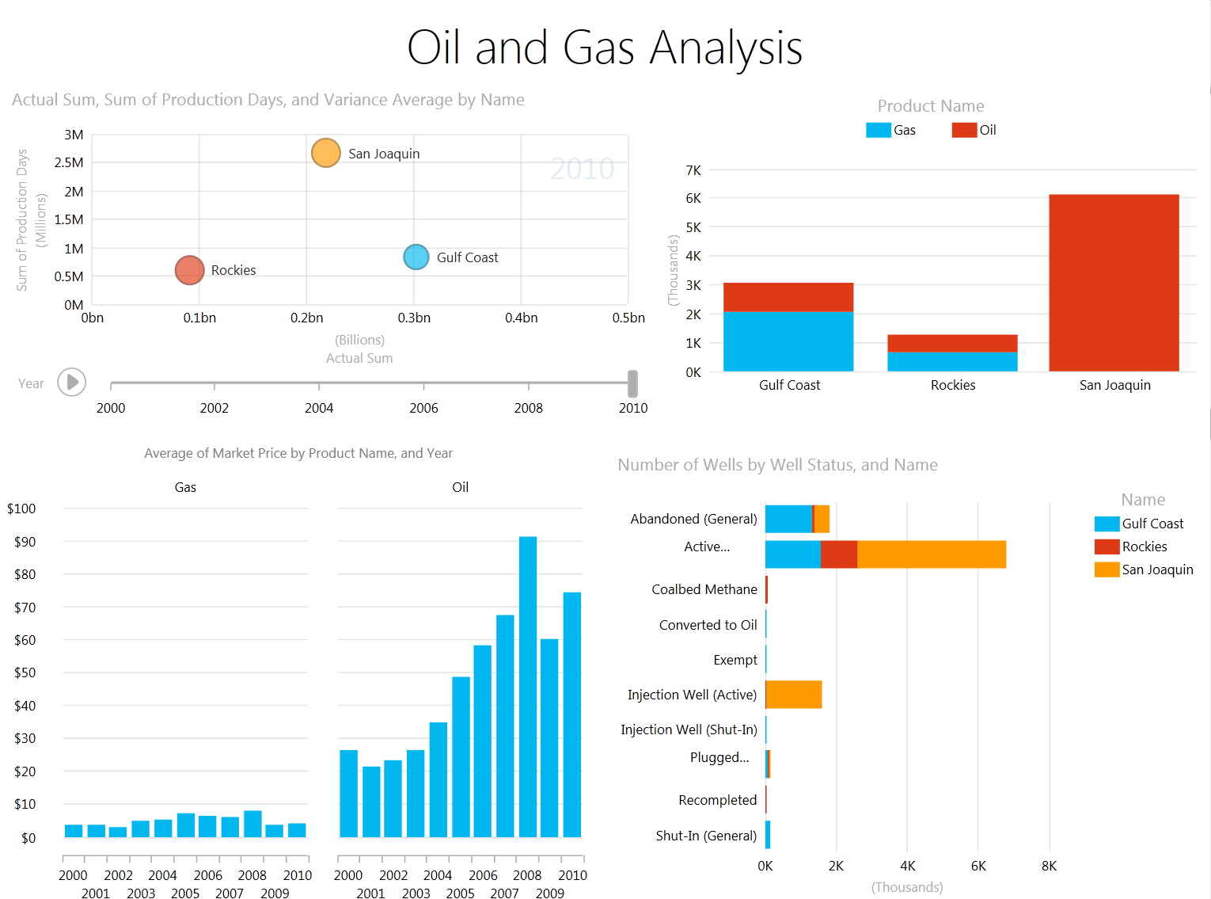
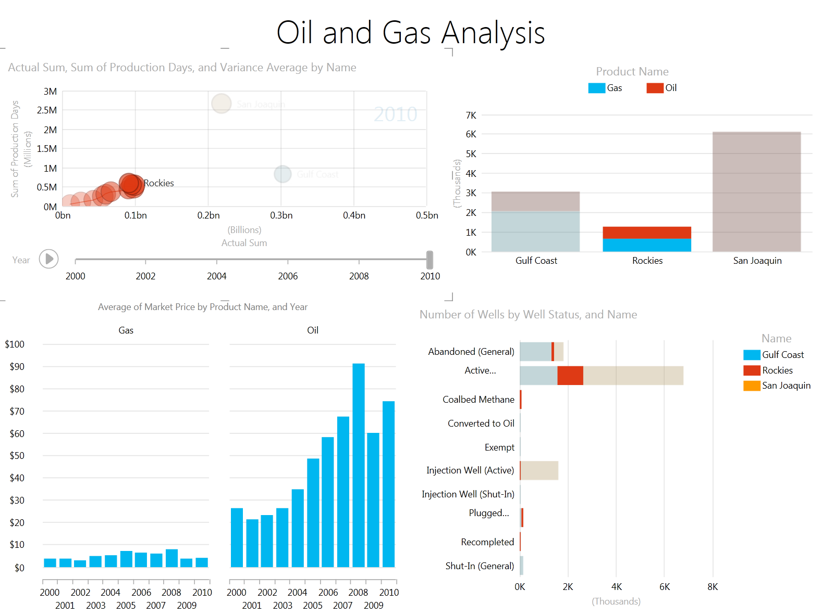

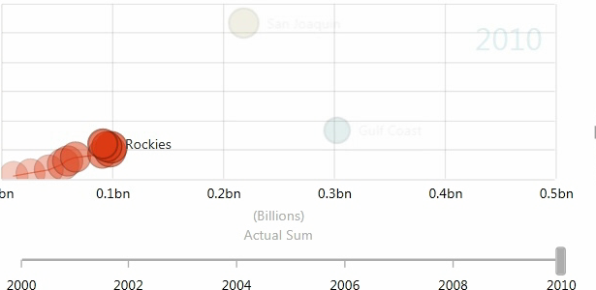

Slide 19
VALUE
Insights &
Actions
KNOWLEDGE
INFORMATION
Recommend
Share
DATA
WORLD DATA
Integrate
COMMUNITY DATA
Publish
Discover
SIGNAL
ORGANIZATIONAL DATA
MY DATA
REFINE
COMBINE

Slide 20





Community & Ecosystem
The Apache Software Foundation
Notes:
1. We are working closely with Hortonworks to enable Hadoop on Windows and making other contributions like the JavaScript Framework and Hive ODBC Driver
2. We have seen early successes from a number of Hadoop ecosystem partners like Karmasphere, HStreaming and Datameer in easily porting their solutions to Hadoop on Windows and Azure.

Slide 21



Slide 22
www.microsoft.com/bigdata
Notes:
Could you have imagined 2 years ago, that Microsoft would have been up here talking about Hadoop?

